Slide 1
Color-coded microbeads project
Keiichi Yoshimatsu

Slide 2
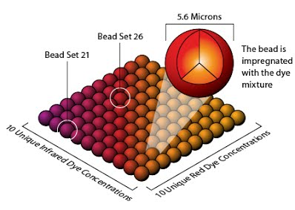
Color-coded microbeads for life-science applications

Slide 3
Previous work by Prof. Doran at University of Minnesota
Color-coded beads ‘decorated’ with ligands (that binds with disease-marker proteins) are mixed with biological samples in order to identify a new ligand for diagnostics.
Reference: A Liquid Array Platform for the Multiplexed Analysis of Synthetic Molecule−Protein Interactions, Todd M. Doran and Thomas Kodadek, ACS Chem. Biol. 2014, 9, 339−346, dx.doi.org/10.1021/cb400806r

Slide 4
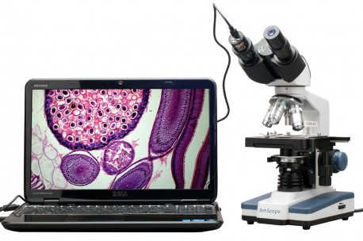
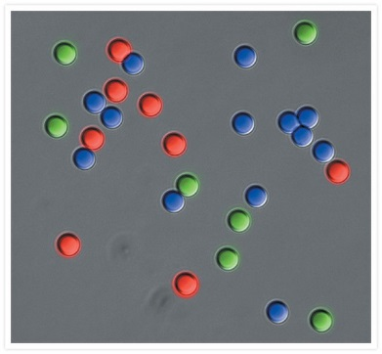
Currently, Dr. Yoshimatsu at MSU is developing a similar but more cost effective method for identifying disease-markers by using color-coded microbeads and microscope.
→ Approach: the use of inexpensive microscope and automated image analysis.

Slide 5
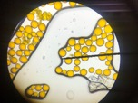
How the microbeads look like in the image.
This is an image of microbeads with a single color.
Dr. Yoshimatsu is currently preparing beads with various colors.
Actual beads to be used will be smaller (1/5 or less in diameter.)

Slide 6
Requirement for software
A) Function to detect and count spherical beads in the image while avoid counting broken (nonspherical) beads.
(Caution! The beads may vary in size.)
B) Function to read out and export the average color intensity of each beads in RGB and Grayscale scale.
Broken beads
spherical beads

Slide 7
Requirement for software
D) Function to compare each image and detect overlaps.
(Caution! The same beads may appear in 2, 3, 4 or more
images. Some beads may appear in only one image.)
E) Function to reconstruct an entire ‘map’ of beads based on the information on the overlaps of images.
Overlap
Overlap
Image 1
Image 2
Image 3

Slide 8
Explanation on Reconstruction of entire “map”
Individual Image 1
Individual Image 2
Individual Image 3
Overlap
Overlap
Entire “map” of beads
Based on the information
of overlaps.

Slide 9
Requirement for software
F) Function to export the following data
1. The center of each bead in x-y coordinate
2. Color of each bead (in RGB and Gray scale)
Entire “map” of beads
Data format (just a suggestion)
X Y R G B Gray Scale
1 6 125 12 4 87
4 5 32 31 13 12
12 67 3 43 120 87
….

Slide 10
Things need to be considered.
The beads will be different in color and size
→ Let the users to customize the parameters for bead detections.
(Optional: can the software automatically optimize the parameters?)
After overlaying, some beads may be distorded (= not spherical).
→ How should we deal with it?
Areas to be used for the quantification of color:
Top 20%?
Central part (circular range within a half in diameter)
Output of color information in several different ways:
RGB, Gray scale, HSB and CYMK
Optional
Detection of crushed beads
Detection of water bubble

